Slide 1
FHIR Questionnaires and Structured Data Capture
Australia WGM
Lloyd McKenzie
February 5, 2020

Slide 2

Who am I?
Name: Lloyd McKenzie
Company: Gevity
Background:
One of FHIR’s 3 initial editors
Co-chair FHIR Management Group and FHIR-Infrastructure
HL7 Fellow
Lead for both the ONC and international FHIR SDC projects
lmckenzie@gevityinc.com

Slide 3
Credit
These slides include content from Brian Postlethwaite
With updates by Lloyd McKenzie

Slide 4
Why use forms?
AllergyIntolerance
Condition
Encounter
FamilyMemberHistory
MedicationStatement
Observation
Patient
100+ other resources
QuestionnaireResponse
or

Slide 5
Forms provide:
Tight control over user experience:
How questions are phrased
What answer choices are permitted
What gets asked when (and in what order)
User interface ‘appearance’
i.e. Consistency in data capture
Full flexibility in what data is captured and how
Very simple data model

Slide 6
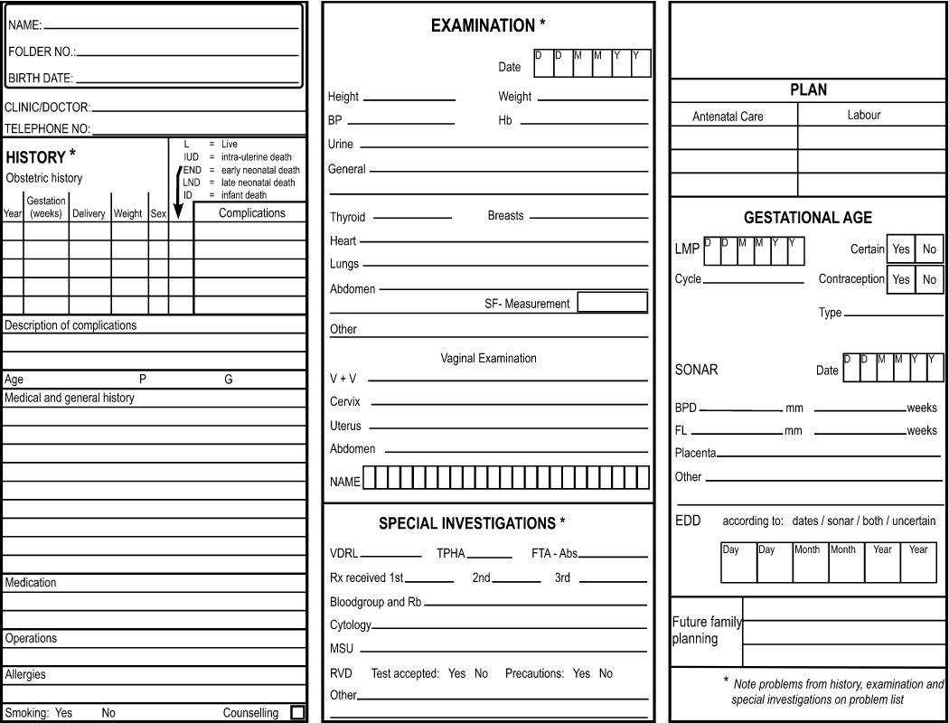
Forms for display

Slide 7
Why use anything other than Forms?
Questionnaire responses aren’t “standard”
Inconsistent over time (different form ‘versions’)
Forms change fairly often
Inconsistent across organizations
Meaning of elements influenced by previous questions
“Address” means different things depending where it appears on the form
In general, can’t query QuestionnaireResponse based on what the answers are

Slide 8
Common pattern
Use forms to capture data
Especially when using ‘simple’ clients
Possibly use ‘population’ to suck in data from existing records
Extract data from form into other resources
Use Provenance to tracker where the data came from
Primarily pass around other resources
Can pass around Provenance and original QuestionnaireResponse if needed

Slide 9
Structured Data Capture

Slide 10
What is Structured Data Capture (SDC)?
Standardize/enhance capabilities of FHIR Questionnaires:
Workflow
Complex form rendering
Complex form behavior
Automatically populating forms
Automatically extracting data from completed forms
Adaptive forms

Slide 11
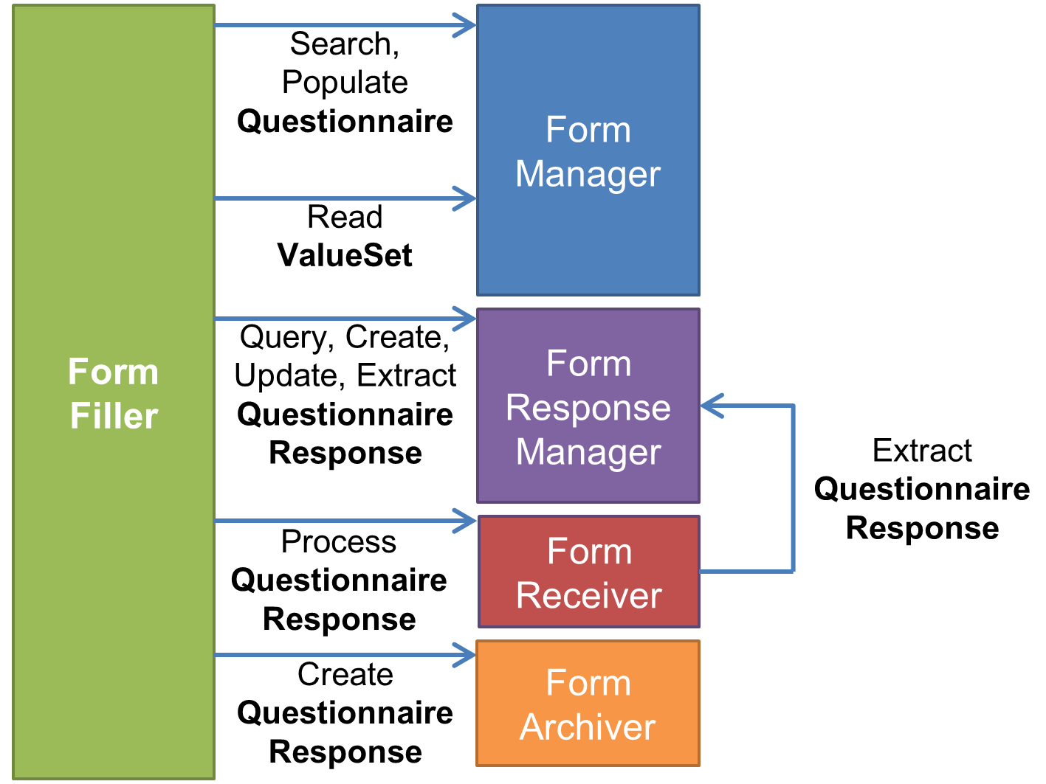
Complex workflow
How do you find a form?
How do you retrieve allowed values?
How do you manage form completion?
How do you submit a form?
How do you ask someone to complete a form?
How do you track whether they’ve filled it out?
How do you derive one form from another?

Slide 12


Complex form rendering
Have questions/instructions render the way you want
Pick at least one green option and no more than one red option
How are you feeling today? is “great”, is “horrible”
Hide or mark certain questions as ‘read only’ (e.g. calculated score)
Should questions be a grid or table? Should a question use a dropdown? Checkboxes? Radio buttons?
And within that, how wide should columns be, what should column headings be, what should the steps on a slider be, etc.
Additional display guidance.
Social Security number:
nnn–nnn-nnn

Slide 13
Complex form behavior
EnableWhen questions based on expressions
If the total score from group 1 > 30, then display these additional cardiology questions
EnableWhen options
Only display “pregnancy” in “reason for absence” if gender = F
Constraints
Can have a maximum of 2 questions with an answer of “most preferred”

Slide 14
Complex form behavior (cont’d)
Constrain values
5-10 characters
January 1-March 30
YYYY-MM
Must be a JPG or PNG, < 500KB
Must be lb or kg
Minimum 3 choices, maximum of 5

Slide 15
Complex form behavior (cont’d)
Constrain references
Answer must be Condition or “Diagnosis Observation”
Possible answers are: Observation?patient=$patient.id&code=12345-5&…
“Click here to create a new value” (launches new questionnaire)

Slide 16
Complex form behavior (cont’d)
Perform calculations (e.g. scores)
Launch context – patient, encounter, etc.
Use CQL or FHIRPath for calculations
Variables, initial expressions
Create forms constructed from other forms

Slide 17
Pre-population
Requires:
context/source
mapping
processing engine
Knowledge of source structures (particularly profiled scope)

Slide 18
Timeline
In January: “July or August”
In June: “September or October”
In November “Probably February”
“Soon”

Slide 19



Questions / Discussion
lmckenzie@gevityinc.com http://hl7.org/fhir/uv/sdc
Or, better yet, include the community and ask/discuss on chat.fhir.org

